Slide 1
Competitive Programming
24 Nov. 2023
Andrei Novikov

Slide 2
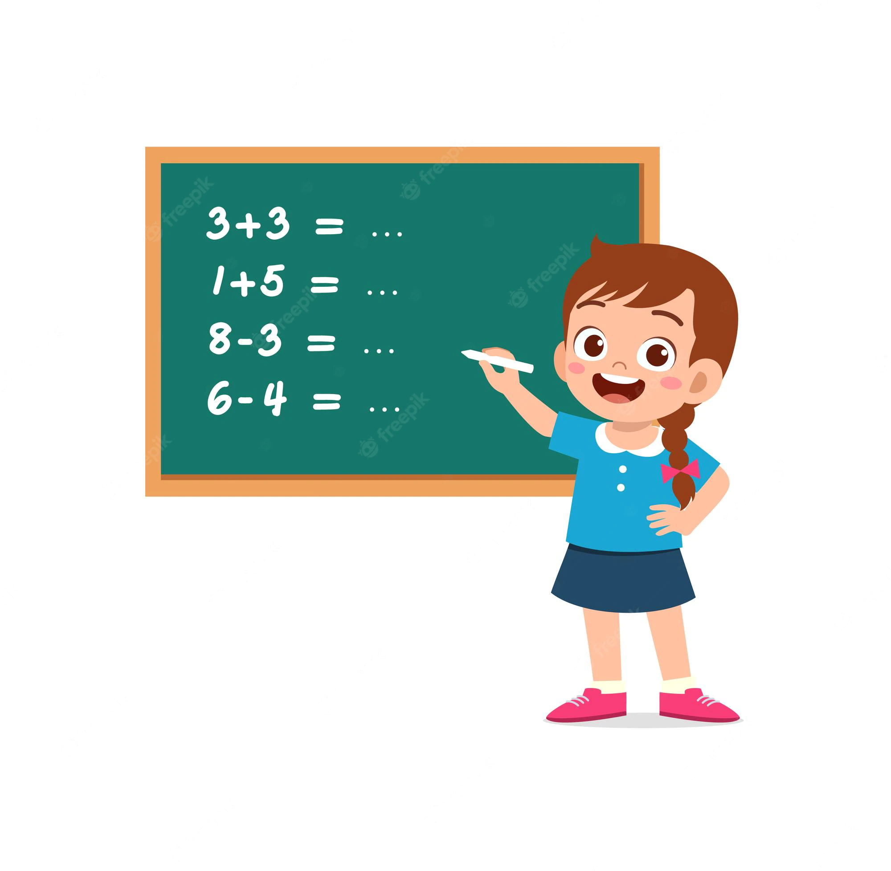
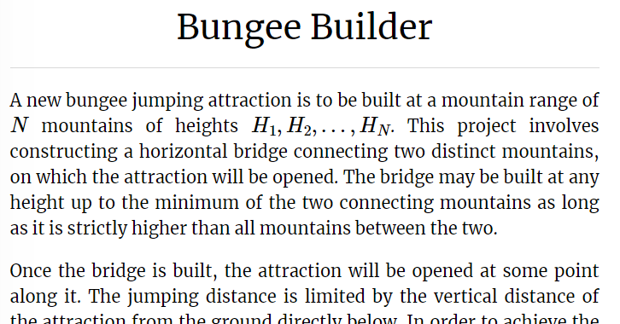
Revise Previous Session by Practice
Kattis - Bungee Builder
Topic: Stack Smart Usage
Link: Link to the Task

Slide 3
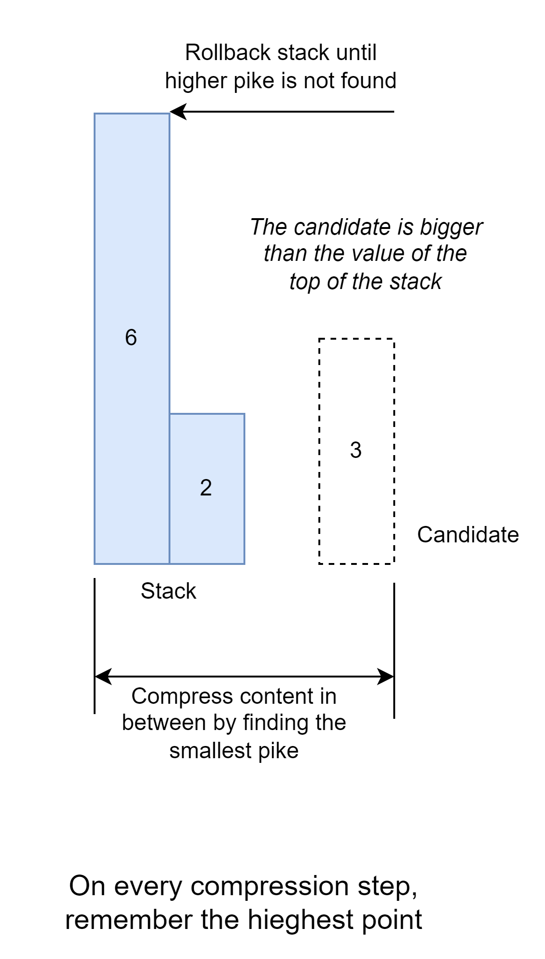
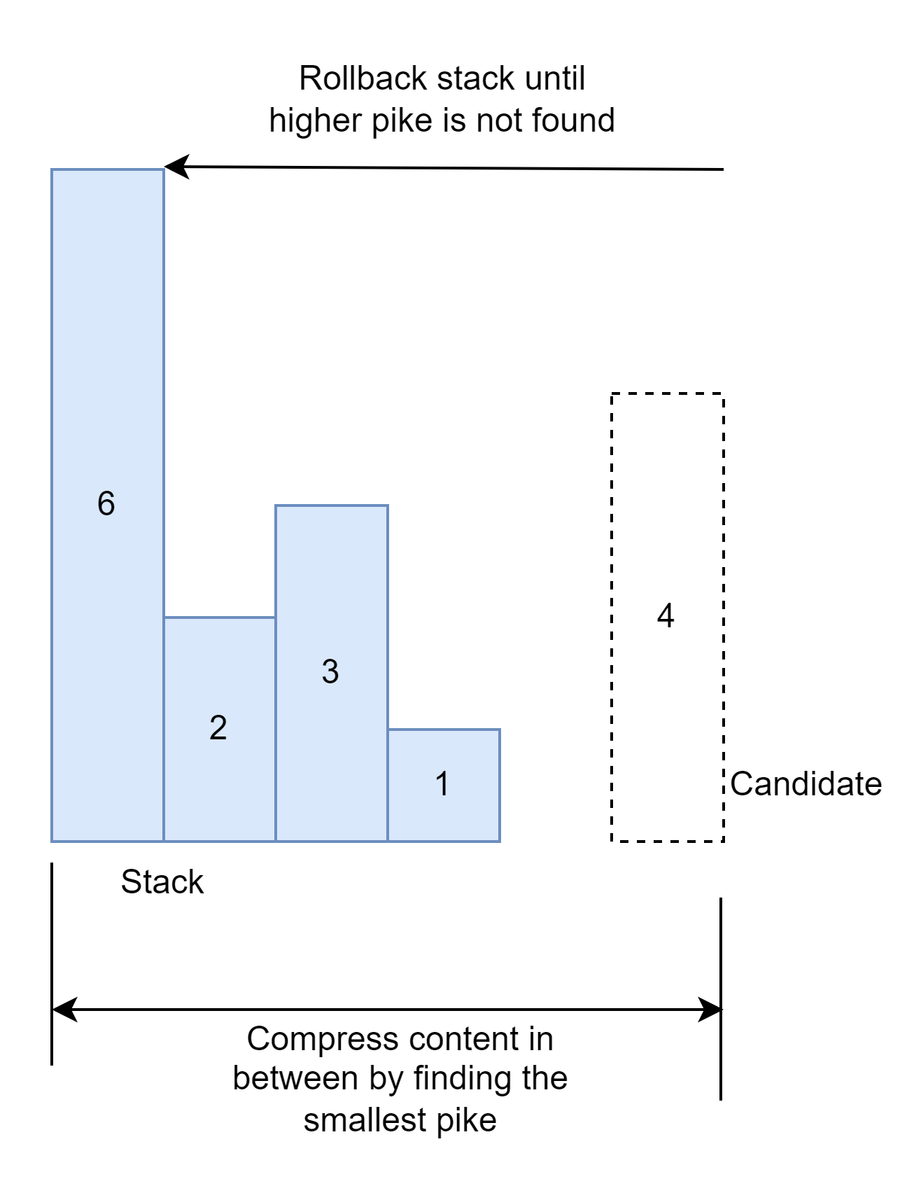
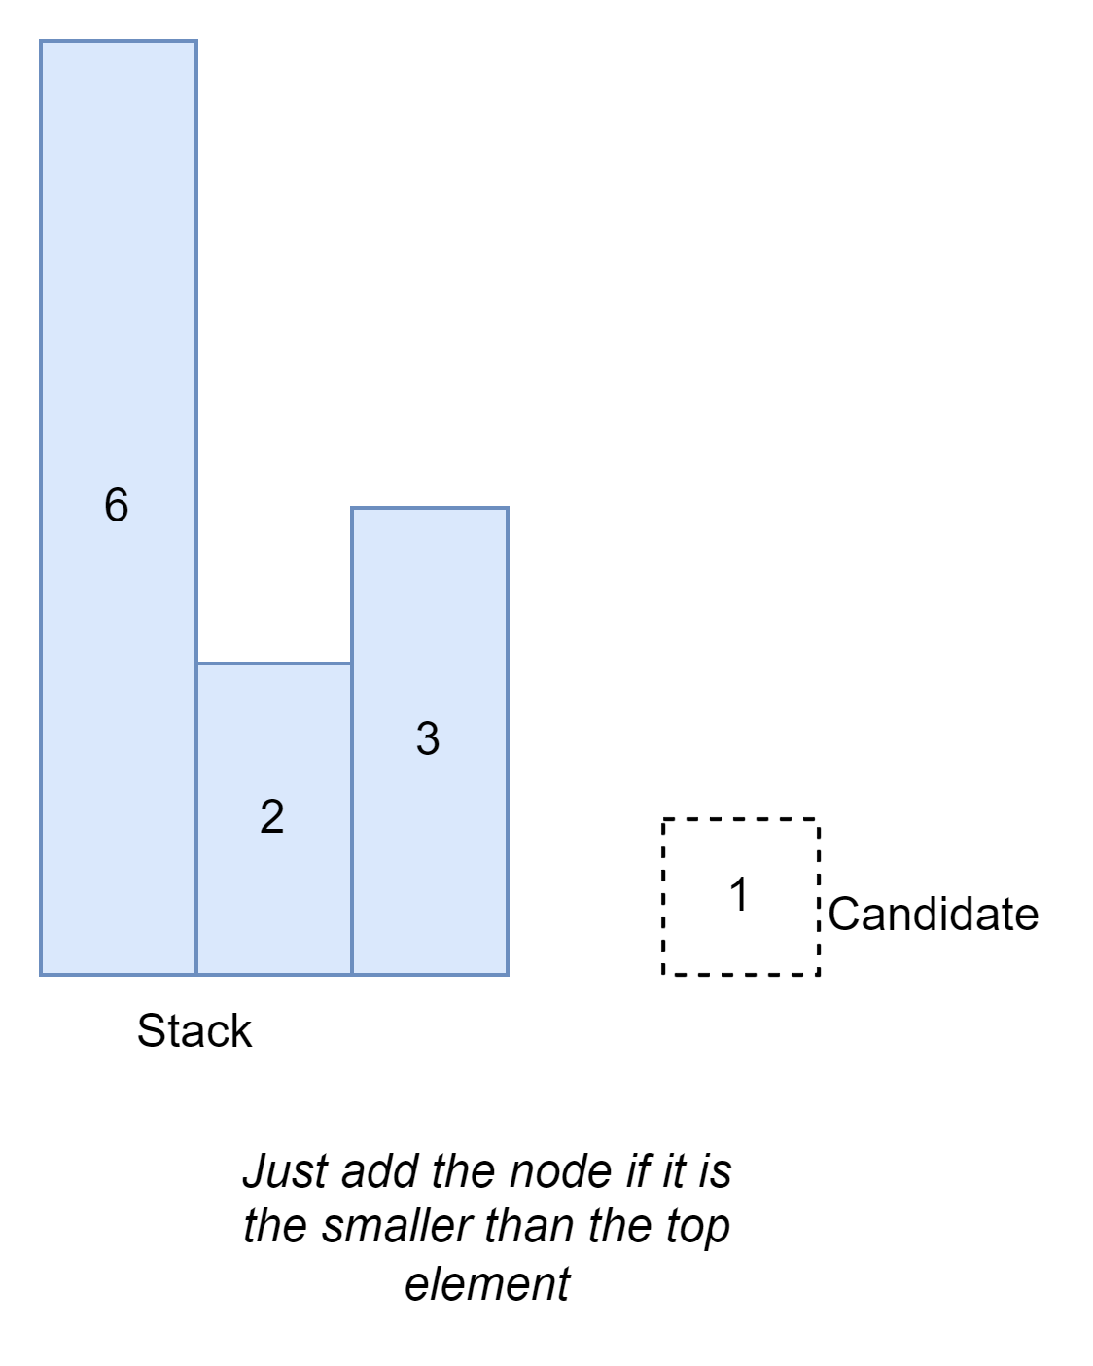
Kattis - Bungee Builder - Approach
1
2
3

Slide 4
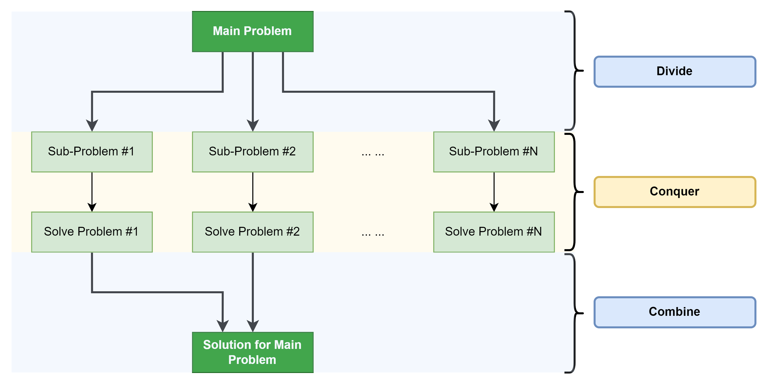
Divide and Conquer
Various O(nlog(n)) sorting algorithm (Merge Sort, Quick Sort, …), Binary Search, etc.

Slide 5
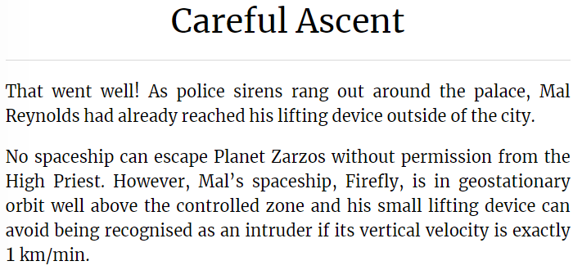
Practice - Careful Ascent
Kattis – Careful Ascent
Topic: Bisection Method
Link: Link to the Task

Slide 6
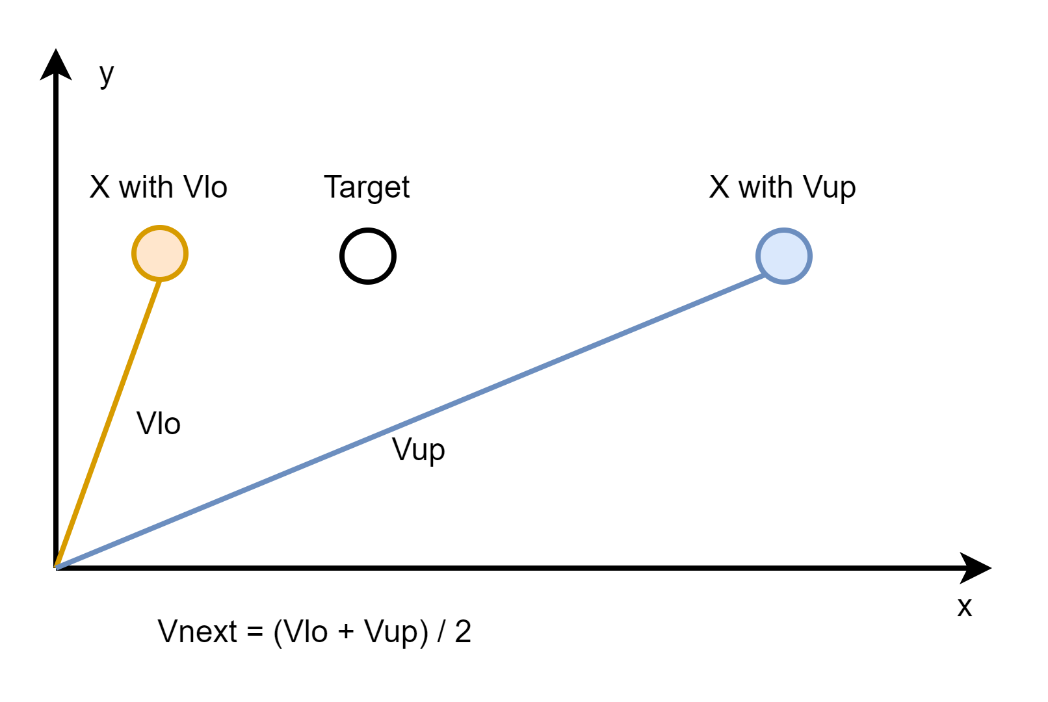
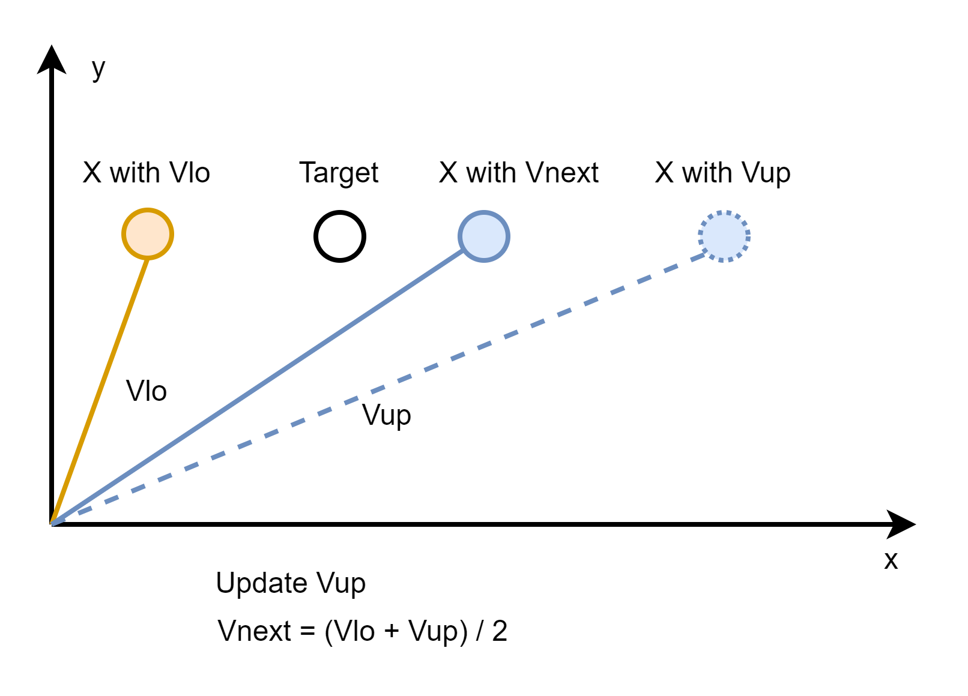
Practice - Careful Ascent - Approach
Simulate with speed Vcur, calculate Vnext based on actual X position;
1
2

Slide 7
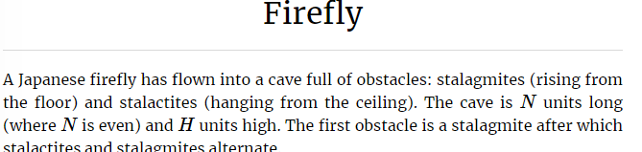
Homework
Kattis - Firefly
Topic: Sorting + Binary Search (solution recommended by the book)
Link to the task
Alternative Approach: Fenwick Tree

Slide 8
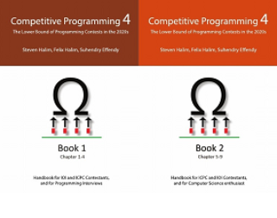
How to Learn and Practice
As one of the recommendation is to use:
Book Competitive Programming 4
Kattis – Link
Online Judge – Link
LeetCode - Link
Few Theory
A Lot of Practice
A Lot of Theory
Almost No Practice

